Slide 1
React JS
(updating the state )
Lecture-18

Slide 2
Today’s Agenda
Why To Update The State ?
Correct Way To Update The State
Points To Remember
Exercises

Slide 3
More On State Management
So far, we have seen how to create state and use state in the Component.
Now let’s understand another topic that is , why and how to update state and what happens after updating a state.

Slide 4
Why To Update The State ?
Here are some reasons why state might change:
In a Timer App , there must be a timer that fires every second to update the current time onscreen
In a Shopping App , the user clicks on a button and a new item should be added and shown in the shopping cart
In an Newtwork based app , some data is received from the server – in response to a request and it must be shown on the screen

Slide 5
How To Update The State ?
To make the state change, the React library gives us a method called setState() that runs asynchronously and allows us to update the value of the state.
The setState() method has the following syntax:
setState(updater, [callback])
updater can either be a function or an object
callback is an optional function that gets executed once the state is successfully updated

Slide 6
Example
import React, { Component } from "react";
class Student extends Component {
constructor(props) {
super(props);
this.state = {
name: this.props.name,
roll: this.props.roll,
};
}
changeData=()=>{
this.setSate({ name: “Ravi”,roll: 20});
}
render() {
return (
<div>
<h3>Name is:{this.state.name}</h3>
<h3>Roll is:{this.state.roll}</h3>
. . . . . . . .
</div>
);
}
}
export default Student;
Imagine changeData() method is called in response to some event like button click
Imagine we have a button here

Slide 7
Four Very Important Points
React re-renders the Component as soon as the state change is done via setState() method. In other words , we can say that render() method is called by React whenever we call setState().
Call to setState() is a request rather than an immediate command to update the component. For better perceived performance, React may delay it, and then update several components in a single pass. It means , React does not guarantee that the state changes are applied immediately.

Slide 8
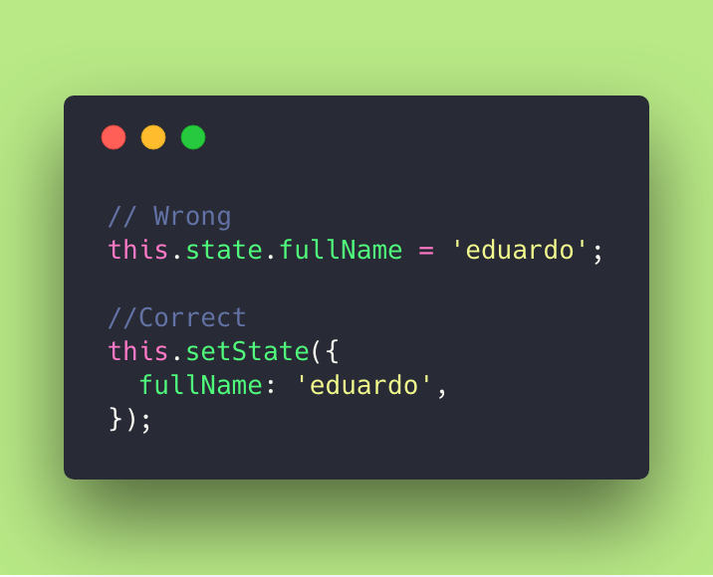
Four Very Important Points
We should never manipulate the state directly , rather it should always be done via setSate() method

Slide 9
Four Very Important Points
this.setState({item: 'newValue’});
The code above calls a this.setState() method and passes in an object with key-value pairs.
If the key matches then it updates the value in state to the new value provided. If the key doesn't exist in state, it will be created with the given value.

Slide 10
Exercise
Create an app with the following files:
ShoppingCart.js: This file should contain 3 methods:
constructor() :Which creates a state object with 2 properties called items and total . The property items must be initialized with props “items” which is an array of strings passed from App.js and total should be initialized with total number of items
updateCart(): This method must be called after 5 seconds and should add a new item called “Dell Inspiron-Laptop” in the items array and also subsequently update the total
render() method render these state values in ShoppingCart component

Slide 11
Exercise
App.js: This file should render the ShoppingCart component by passing a prop called items set to an array of strings as shown:
["One Plus - Mobile", "Fast Track-Watch"]
index.js: To render the App component

Slide 12
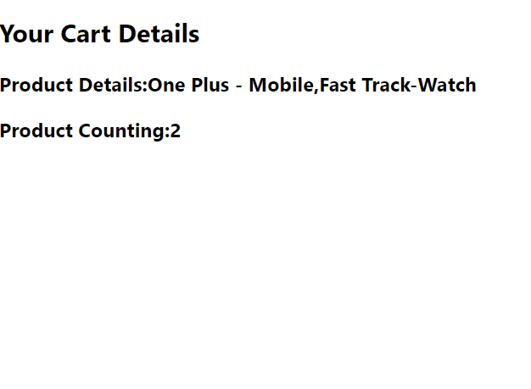
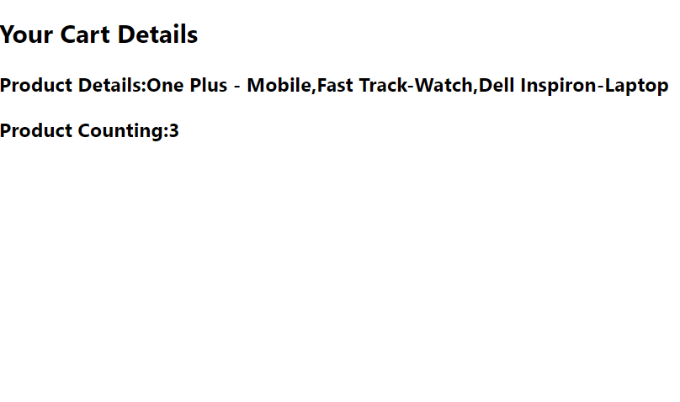
Output
Initial Output
After 5 seconds

Slide 13
Solution
ShoppingCart.js
import React, { Component } from "react";
class ShoppingCart extends Component {
constructor(props) {
super(props);
this.state = { items: this.props.items, total: this.props.items.length };
setTimeout(this.updateCart, 5000);
}
updateCart = () => {
let newItems = [...this.state.items, "Dell Inspiron-Laptop"];
let newTotal = this.state.total + 1;
this.setState({ items: newItems, total: newTotal });
};
render() {
return (
<div>
<h2>Your Cart Details</h2>
<h3>Product Details:{this.state.items.join()}</h3>
<h3>Product Counting:{this.state.total}</h3>
</div>
);
}
}
export default ShoppingCart;

Slide 14
Solution
App..js
import React, { Component } from "react";
import ShoppingCart from "./ShoppingCart";
class App extends Component {
render() {
return (
<div>
<ShoppingCart items={["One Plus - Mobile", "Fast Track-Watch"]} />
</div>
);
}
}
export default App;

Slide 15
Exercise
Create an app with the following files:
Clock.js: To render and update the current date and time after every second
App.js: This file should render the Clock component
index.js: To render the App component

Slide 16
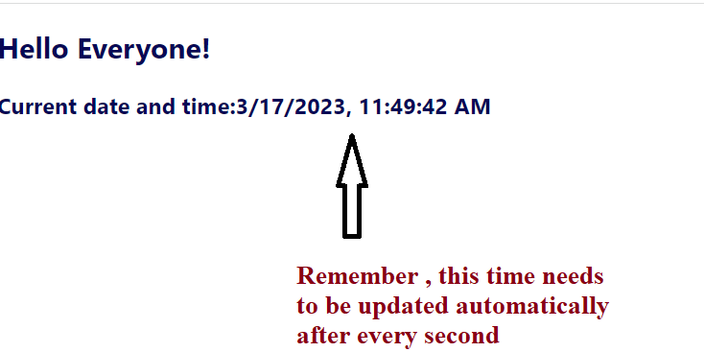
Output

Slide 17
Props V/s State
PROPS | STATE
Props are used for passing data to child components | State is used for setting up data of component , both initially and upon user interaction.
Props are usually passed down from “above” i.e from parent components | State is created in the component, it gets its initial data in the constructor() method
Props are immutable to the component receiving them. We don't change the props passed to a component from within the component | State is changeable, React uses the setState() method to update the object of a state. State can only be mutated by the component that contains the state. It is private in this sense.

